Slide 1
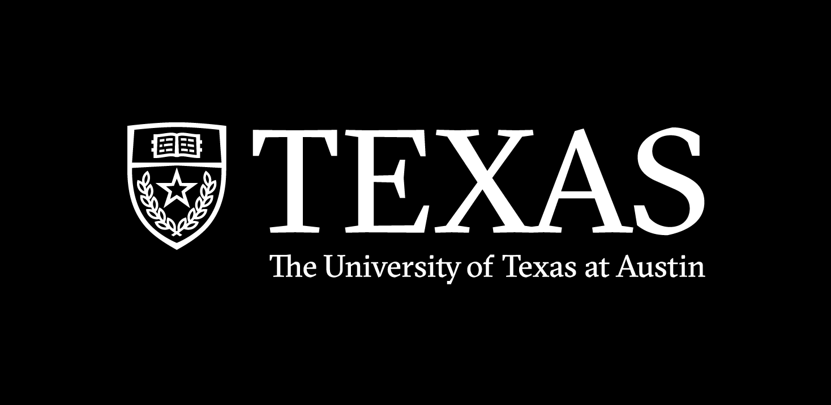
Spring 2022
hidden markov models
Programming and Data Analysis for Modern Neuroscience
NEU 365P/385L
Marcel Goldschen-ohm
Assistant Professor in the Department of Neuroscience, The University of Texas at Austin

Slide 2
Learning Objectives
You will

Slide 3
Hidden Markov Models (HMMs)
States
represent the distinct
configurations of the
system being modeled.
e.g., Sunny, Rainy, Cloudy
for a model of the weather
e.g., Inactive, Active, Blocked
for a model of a protein
State A
State C
State B
Transitions
occur at an average rate.
Notes:
Their dysfunction is related to disorders such as epilepsy, autism spectrum disorder, intellectual disability, schizophrenia, and neurodevelopmental disorders such as fragile X syndrome. Altered GABAAR expression is also a common feature of Alzheimer’s, Parkinson’s and Huntington’s disease.

Slide 4
Hidden Markov Models (HMMs)
States
represent the distinct
configurations of the
system being modeled.
e.g., Sunny, Rainy, Cloudy
for a model of the weather
e.g., Inactive, Active, Blocked
for a model of a protein
State A
State C
What distribution describes the lifetime in each state?
State B
Transitions
occur at an average rate.
Notes:
Their dysfunction is related to disorders such as epilepsy, autism spectrum disorder, intellectual disability, schizophrenia, and neurodevelopmental disorders such as fragile X syndrome. Altered GABAAR expression is also a common feature of Alzheimer’s, Parkinson’s and Huntington’s disease.

Slide 5
Transition probabilities per time step.
States
represent the distinct
configurations of the
system being modeled.
e.g., Sunny, Rainy, Cloudy
for a model of the weather
e.g., Inactive, Active, Blocked
for a model of a protein
State A
0.6
State C
0.2
0.3
0.4
Transitions
For discrete time steps, transitions are often parameterized as a probability of occurring each time step.
State B
0.1

Slide 6
HMMs are memoryless.
Memoryless
Only care where we are,
not where we’ve been.
State A
State C
State B

Slide 7
Simple HMM for an Ion Channel
Open
Desensitized
Closed

Slide 8
One possible state sequence (discrete time steps):
COOCODDDCOOCCDDDDDDCCODDDCOOOCODD…
Open
Desensitized
Closed

Slide 9
Hidden States: Observed (pA):
COOCODDDCOOCCDDDDDDCCODDDCOOOCODD…
055050000550000000000500005550500…
5 pA
Open
Desensitized
0 pA
Closed
0 pA

Slide 10
Hidden States: Observed (pA):
COOCODDDCOOCCDDDDDDCCODDDCOOOCODD…
054161001560001100100301014450610…
N(5,2) pA
Open
Desensitized
N(0,1) pA
Closed
N(0,1) pA

Slide 11
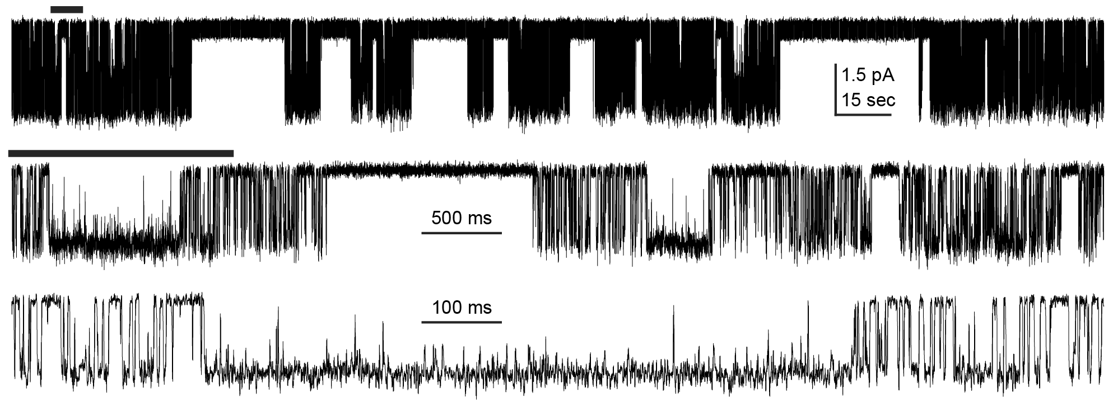
Can you guess how many closed and open states the channel visits (openings are downwards)?

Slide 12
HMM
Simulation
Hidden States
COOCODDDCOOCCDDDDDDCCODDDCOOOCODD…
Observations
054161001560001100100301014450610…
Modeling

Slide 13
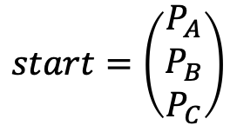
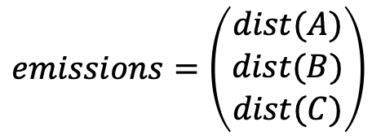
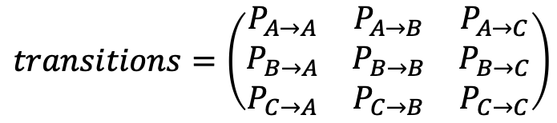
Parts of an HMM
$$start=\left(\begin{matrix}P_{A} \\ P_{B} \\ P_{C}\end{matrix}\right)$$
$$transitions=\left(\begin{matrix}P_{A→A} & P_{A→B} & P_{A→C} \\ P_{B→A} & P_{B→B} & P_{B→C} \\ P_{C→A} & P_{C→B} & P_{C→C}\end{matrix}\right)$$
$$emissions=\left(\begin{matrix}dist(A) \\ dist(B) \\ dist(C)\end{matrix}\right)$$

Slide 14
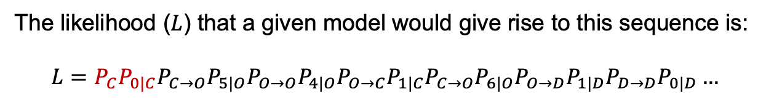
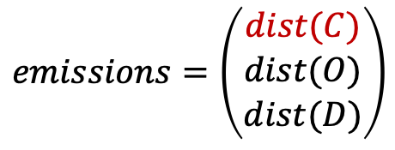
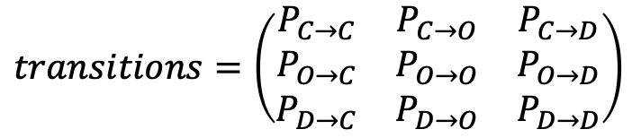
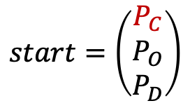
Consider the following sequence:
COOCODD…
Hidden States: Observed (pA):
0541610…
The likelihood ($L$) that a given model would give rise to this sequence is:
$$L=P_{C}P_{0|C}P_{C→O}P_{5|O}P_{O→O}P_{4|O}P_{O→C}P_{1|C}P_{C→O}P_{6|O}P_{O→D}P_{1|D}P_{D→D}P_{0|D}…$$
$$start=\left(\begin{matrix}P_{C} \\ P_{O} \\ P_{D}\end{matrix}\right)$$
$$transitions=\left(\begin{matrix}P_{C→C} & P_{C→O} & P_{C→D} \\ P_{O→C} & P_{O→O} & P_{O→D} \\ P_{D→C} & P_{D→O} & P_{D→D}\end{matrix}\right)$$
$$emissions=\left(\begin{matrix}dist(C) \\ dist(O) \\ dist(D)\end{matrix}\right)$$

Slide 15
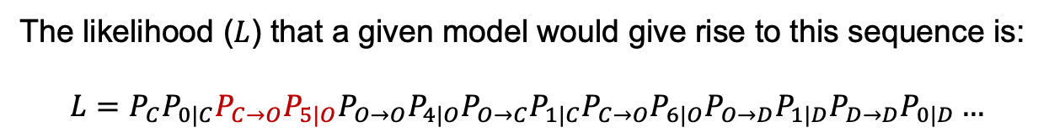
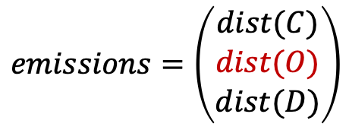
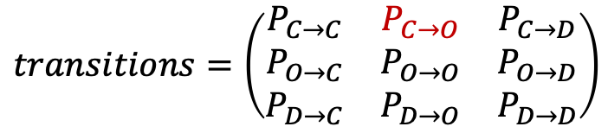
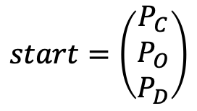
Consider the following sequence:
COOCODD…
Hidden States: Observed (pA):
0541610…
The likelihood ($L$) that a given model would give rise to this sequence is:
$$L=P_{C}P_{0|C}P_{C→O}P_{5|O}P_{O→O}P_{4|O}P_{O→C}P_{1|C}P_{C→O}P_{6|O}P_{O→D}P_{1|D}P_{D→D}P_{0|D}…$$
$$start=\left(\begin{matrix}P_{C} \\ P_{O} \\ P_{D}\end{matrix}\right)$$
$$transitions=\left(\begin{matrix}P_{C→C} & P_{C→O} & P_{C→D} \\ P_{O→C} & P_{O→O} & P_{O→D} \\ P_{D→C} & P_{D→O} & P_{D→D}\end{matrix}\right)$$
$$emissions=\left(\begin{matrix}dist(C) \\ dist(O) \\ dist(D)\end{matrix}\right)$$

Slide 16
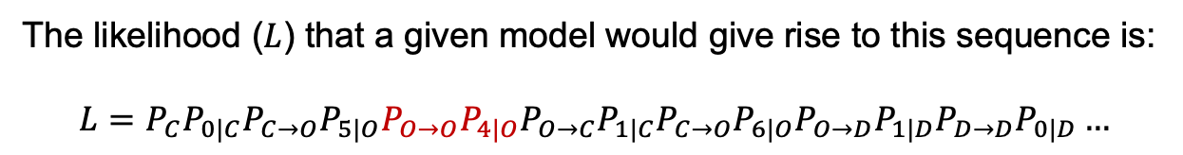
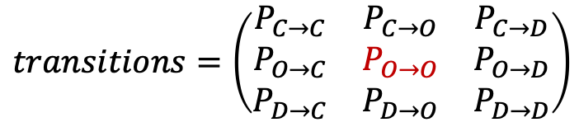
Consider the following sequence:
COOCODD…
Hidden States: Observed (pA):
0541610…
The likelihood ($L$) that a given model would give rise to this sequence is:
$$L=P_{C}P_{0|C}P_{C→O}P_{5|O}P_{O→O}P_{4|O}P_{O→C}P_{1|C}P_{C→O}P_{6|O}P_{O→D}P_{1|D}P_{D→D}P_{0|D}…$$
$$start=\left(\begin{matrix}P_{C} \\ P_{O} \\ P_{D}\end{matrix}\right)$$
$$transitions=\left(\begin{matrix}P_{C→C} & P_{C→O} & P_{C→D} \\ P_{O→C} & P_{O→O} & P_{O→D} \\ P_{D→C} & P_{D→O} & P_{D→D}\end{matrix}\right)$$
$$emissions=\left(\begin{matrix}dist(C) \\ dist(O) \\ dist(D)\end{matrix}\right)$$

Slide 17
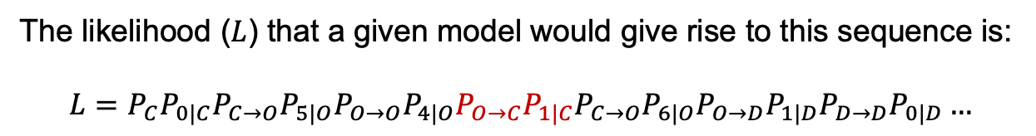
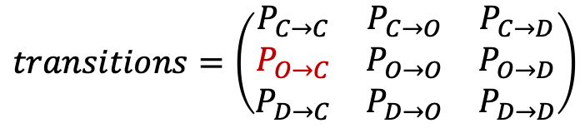
Consider the following sequence:
COOCODD…
Hidden States: Observed (pA):
0541610…
The likelihood ($L$) that a given model would give rise to this sequence is:
$$L=P_{C}P_{0|C}P_{C→O}P_{5|O}P_{O→O}P_{4|O}P_{O→C}P_{1|C}P_{C→O}P_{6|O}P_{O→D}P_{1|D}P_{D→D}P_{0|D}…$$
$$start=\left(\begin{matrix}P_{C} \\ P_{O} \\ P_{D}\end{matrix}\right)$$
$$transitions=\left(\begin{matrix}P_{C→C} & P_{C→O} & P_{C→D} \\ P_{O→C} & P_{O→O} & P_{O→D} \\ P_{D→C} & P_{D→O} & P_{D→D}\end{matrix}\right)$$
$$emissions=\left(\begin{matrix}dist(C) \\ dist(O) \\ dist(D)\end{matrix}\right)$$

Slide 18
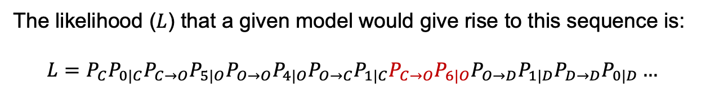
Consider the following sequence:
COOCODD…
Hidden States: Observed (pA):
0541610…
The likelihood ($L$) that a given model would give rise to this sequence is:
$$L=P_{C}P_{0|C}P_{C→O}P_{5|O}P_{O→O}P_{4|O}P_{O→C}P_{1|C}P_{C→O}P_{6|O}P_{O→D}P_{1|D}P_{D→D}P_{0|D}…$$
$$start=\left(\begin{matrix}P_{C} \\ P_{O} \\ P_{D}\end{matrix}\right)$$
$$transitions=\left(\begin{matrix}P_{C→C} & P_{C→O} & P_{C→D} \\ P_{O→C} & P_{O→O} & P_{O→D} \\ P_{D→C} & P_{D→O} & P_{D→D}\end{matrix}\right)$$
$$emissions=\left(\begin{matrix}dist(C) \\ dist(O) \\ dist(D)\end{matrix}\right)$$

Slide 19
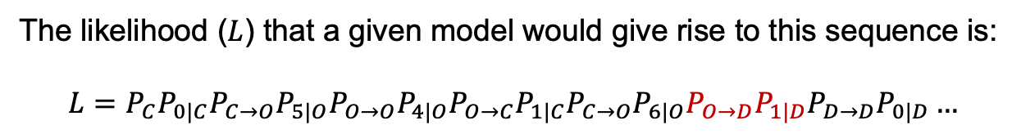
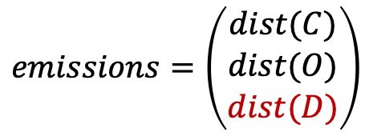
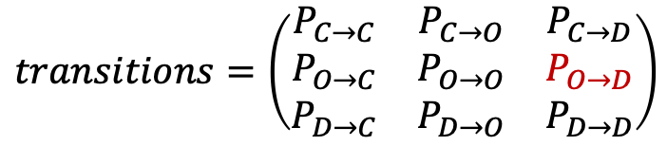
Consider the following sequence:
COOCODD…
Hidden States: Observed (pA):
0541610…
The likelihood ($L$) that a given model would give rise to this sequence is:
$$L=P_{C}P_{0|C}P_{C→O}P_{5|O}P_{O→O}P_{4|O}P_{O→C}P_{1|C}P_{C→O}P_{6|O}P_{O→D}P_{1|D}P_{D→D}P_{0|D}…$$
$$start=\left(\begin{matrix}P_{C} \\ P_{O} \\ P_{D}\end{matrix}\right)$$
$$transitions=\left(\begin{matrix}P_{C→C} & P_{C→O} & P_{C→D} \\ P_{O→C} & P_{O→O} & P_{O→D} \\ P_{D→C} & P_{D→O} & P_{D→D}\end{matrix}\right)$$
$$emissions=\left(\begin{matrix}dist(C) \\ dist(O) \\ dist(D)\end{matrix}\right)$$

Slide 20
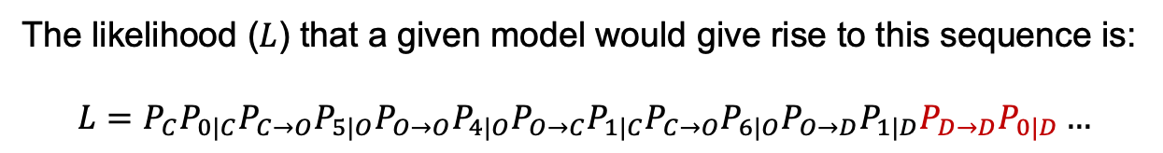
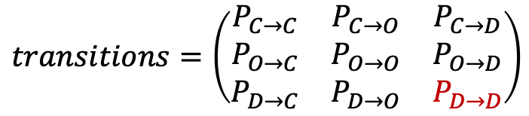
Consider the following sequence:
COOCODD…
Hidden States: Observed (pA):
0541610…
The likelihood ($L$) that a given model would give rise to this sequence is:
$$L=P_{C}P_{0|C}P_{C→O}P_{5|O}P_{O→O}P_{4|O}P_{O→C}P_{1|C}P_{C→O}P_{6|O}P_{O→D}P_{1|D}P_{D→D}P_{0|D}…$$
$$start=\left(\begin{matrix}P_{C} \\ P_{O} \\ P_{D}\end{matrix}\right)$$
$$transitions=\left(\begin{matrix}P_{C→C} & P_{C→O} & P_{C→D} \\ P_{O→C} & P_{O→O} & P_{O→D} \\ P_{D→C} & P_{D→O} & P_{D→D}\end{matrix}\right)$$
$$emissions=\left(\begin{matrix}dist(C) \\ dist(O) \\ dist(D)\end{matrix}\right)$$

Slide 21
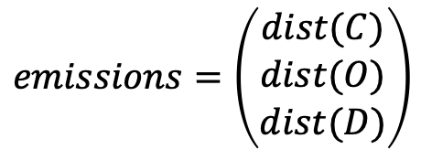
But the states are hidden.
???????…
Hidden States: Observed (pA):
0541610…
There are many sequences of states that might give rise to the same sequence of observations.
$$start=\left(\begin{matrix}P_{C} \\ P_{O} \\ P_{D}\end{matrix}\right)$$
$$transitions=\left(\begin{matrix}P_{C→C} & P_{C→O} & P_{C→D} \\ P_{O→C} & P_{O→O} & P_{O→D} \\ P_{D→C} & P_{D→O} & P_{D→D}\end{matrix}\right)$$
$$emissions=\left(\begin{matrix}dist(C) \\ dist(O) \\ dist(D)\end{matrix}\right)$$

Slide 22
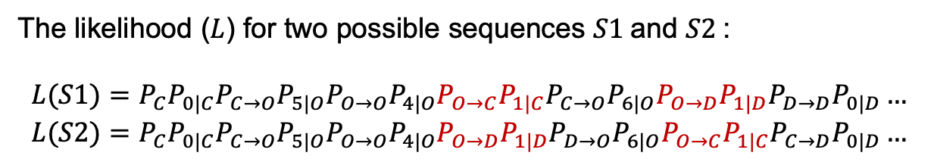
But the states are hidden.
???????…
Hidden States: Observed (pA):
0541610…
The likelihood ($L$) for two possible sequences $S1$and $S2$:
$$L(S1)=P_{C}P_{0|C}P_{C→O}P_{5|O}P_{O→O}P_{4|O}P_{O→C}P_{1|C}P_{C→O}P_{6|O}P_{O→D}P_{1|D}P_{D→D}P_{0|D}…$$
$$L(S2)=P_{C}P_{0|C}P_{C→O}P_{5|O}P_{O→O}P_{4|O}P_{O→D}P_{1|D}P_{D→O}P_{6|O}P_{O→C}P_{1|C}P_{C→D}P_{0|D}…$$
$$start=\left(\begin{matrix}P_{C} \\ P_{O} \\ P_{D}\end{matrix}\right)$$
$$transitions=\left(\begin{matrix}P_{C→C} & P_{C→O} & P_{C→D} \\ P_{O→C} & P_{O→O} & P_{O→D} \\ P_{D→C} & P_{D→O} & P_{D→D}\end{matrix}\right)$$
$$emissions=\left(\begin{matrix}dist(C) \\ dist(O) \\ dist(D)\end{matrix}\right)$$

Slide 23
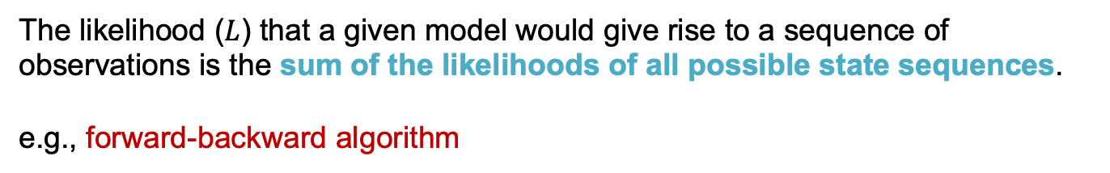
But the states are hidden.
???????…
Hidden States: Observed (pA):
0541610…
The likelihood ($L$) that a given model would give rise to a sequence of observations is the sum of the likelihoods of all possible state sequences.
e.g., forward-backward algorithm
$$start=\left(\begin{matrix}P_{C} \\ P_{O} \\ P_{D}\end{matrix}\right)$$
$$transitions=\left(\begin{matrix}P_{C→C} & P_{C→O} & P_{C→D} \\ P_{O→C} & P_{O→O} & P_{O→D} \\ P_{D→C} & P_{D→O} & P_{D→D}\end{matrix}\right)$$
$$emissions=\left(\begin{matrix}dist(C) \\ dist(O) \\ dist(D)\end{matrix}\right)$$

Slide 24
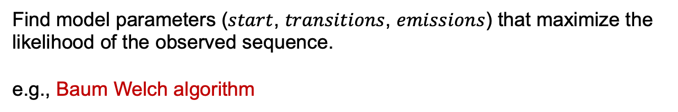
Modeling an observed sequence.
?????????????????????????????????…
Hidden States: Observed (pA):
054161001560001100100301014450610…
Find model parameters ($start$, $transitions$, $emissions$) that maximize the likelihood of the observed sequence.
e.g., Baum Welch algorithm
$$start=\left(\begin{matrix}P_{C} \\ P_{O} \\ P_{D}\end{matrix}\right)$$
$$transitions=\left(\begin{matrix}P_{C→C} & P_{C→O} & P_{C→D} \\ P_{O→C} & P_{O→O} & P_{O→D} \\ P_{D→C} & P_{D→O} & P_{D→D}\end{matrix}\right)$$
$$emissions=\left(\begin{matrix}dist(C) \\ dist(O) \\ dist(D)\end{matrix}\right)$$

